Slide 1
R-01A Resolving Boot Failure with Multiple USB Devices Connected
NVL-S RVP
Required Rework Document

Slide 2
R-01A
Resolving Boot Failure with Multiple USB Devices Connected
Change Log | 2025 WW29 - Initial 2025 WW30 - Add more information for reworking
Description | Resolving Boot Failure with Multiple USB Devices Connected
Impact | The board may occasionally fail to boot when multiple USB devices are connected. The onboard LEDs will continue blinking or the board will be restarted occasionally.
Rework Involved | SMD Capacitors, resistors and blue wire.
SKUs | S-031 FAB1
Contacts | Chen, Ellen ; Wang, Ivan B
HSD Link | N/A
Collateral Link | N/A
SW Dependency | N/A

Slide 3
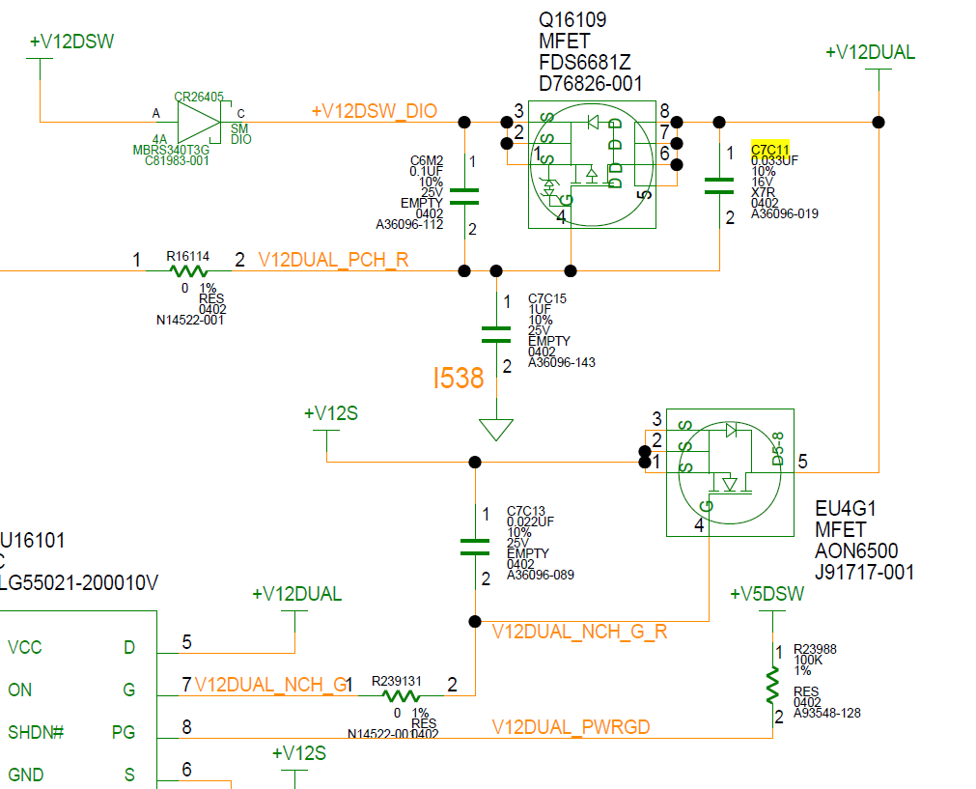
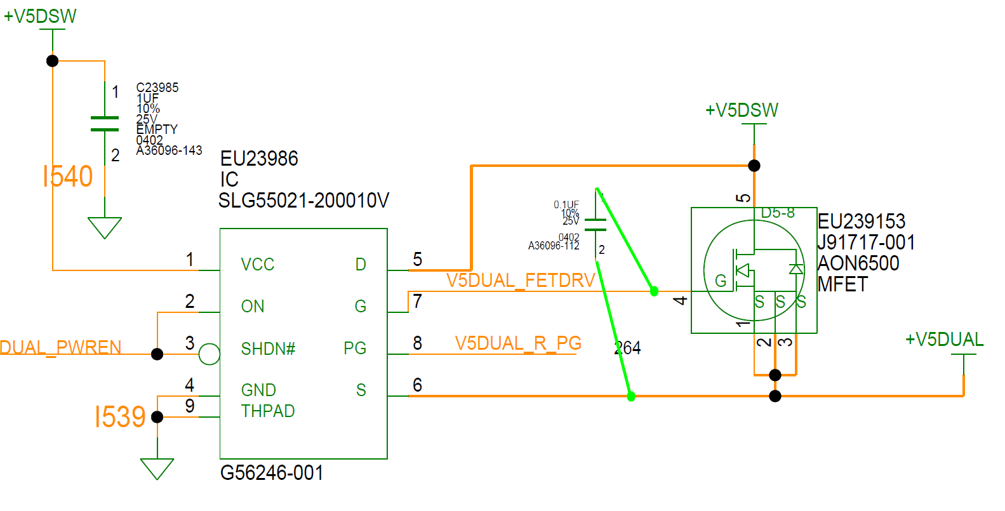
NVL-S RVP S-031 Top

Slide 4
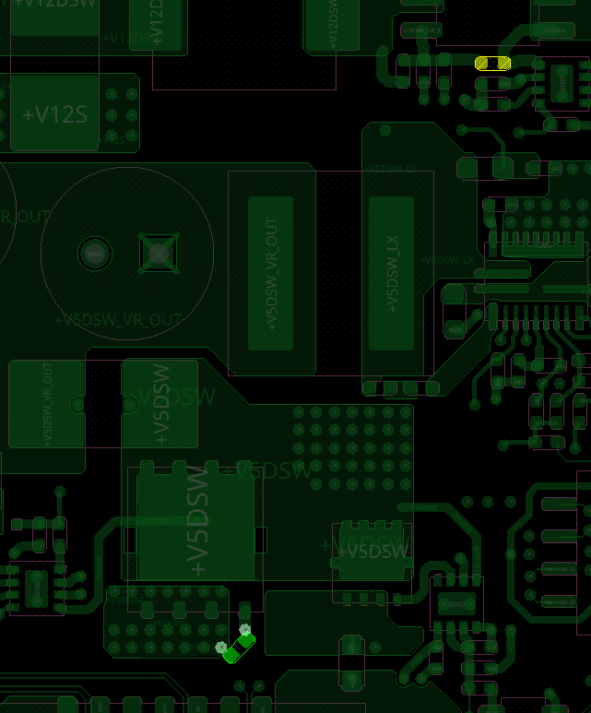
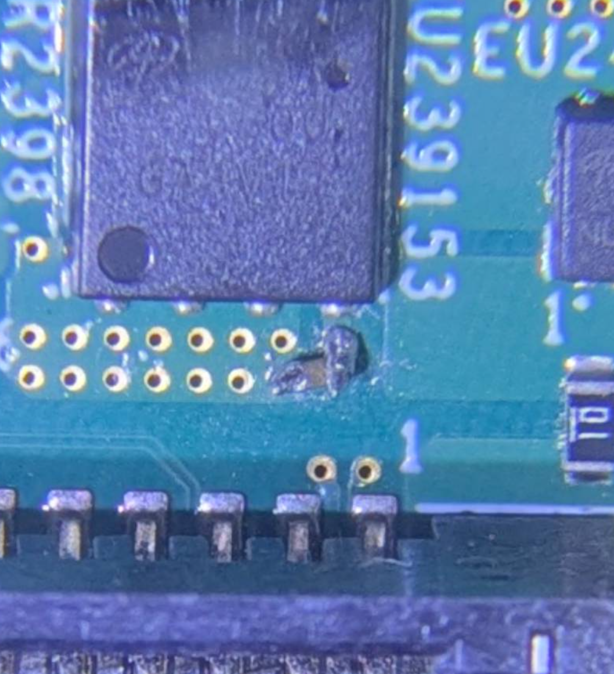
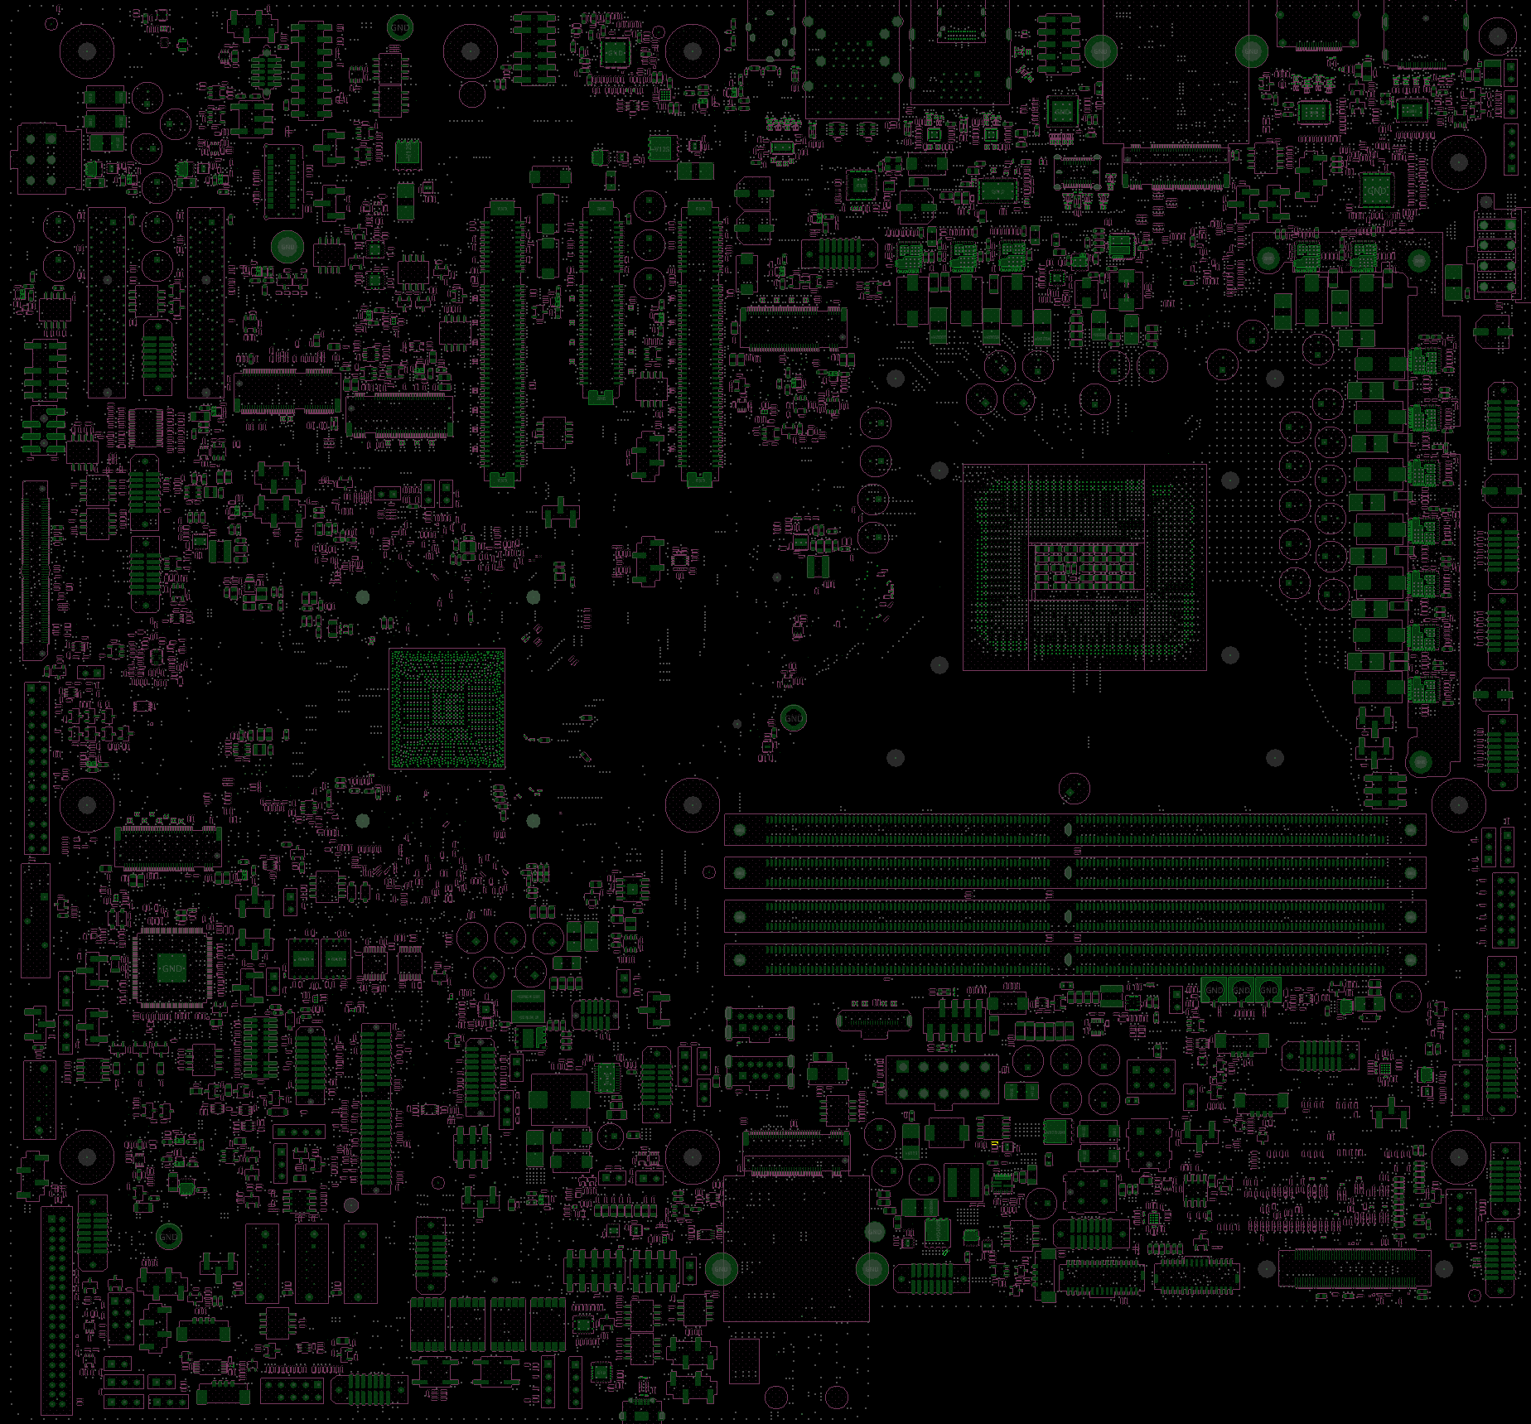
NVL-S RVP S-031
Step 1 of 1
C7C11
Action | REFDES | Description
REPLACE | C7C11 | CAPC,X7R,0402,0.1UF,25.00V,+/- 10%
STUFF | Solder onto the VIAs of +V5DUAL & V5DUAL_FETDRV directly | CAPC,X7R,0402,0.1UF,25.00V,+/- 10%
VIA of V5DUAL_FETDRV
Solder a cap onto the VIAs of V5DUAL_FETDRV and +V5DUAL directly
TOP
VIA of +V5DUAL

Slide 5
NVL-S RVP S-031
R-01A Resolving Boot Failure with Multiple USB Devices Connected Rework Summary-1
Action | Item | REFDES | Current IPN | Description | New IPN | Description
REPLACE | capacitor | C7C11 | A36096-019 | CAPC,X7R,0402,0.033 UF,16.000V,+/- 10% | A36096-112 | CAPC,X7R,0402,0.1UF,25.00V,+/- 10%
STUFF | NA | Solder onto the VIAs of +V5DUAL and V5DUAL_FETDRV directly | NA | NA | A36096-112 | CAPC,X7R,0402,0.1UF,25.00V,+/- 10%

Slide 6
The following reworks are workarounds for boards mounted with the older version of the V5DSW voltage regulator.
Only the WO# U25623 is needed.

Slide 7
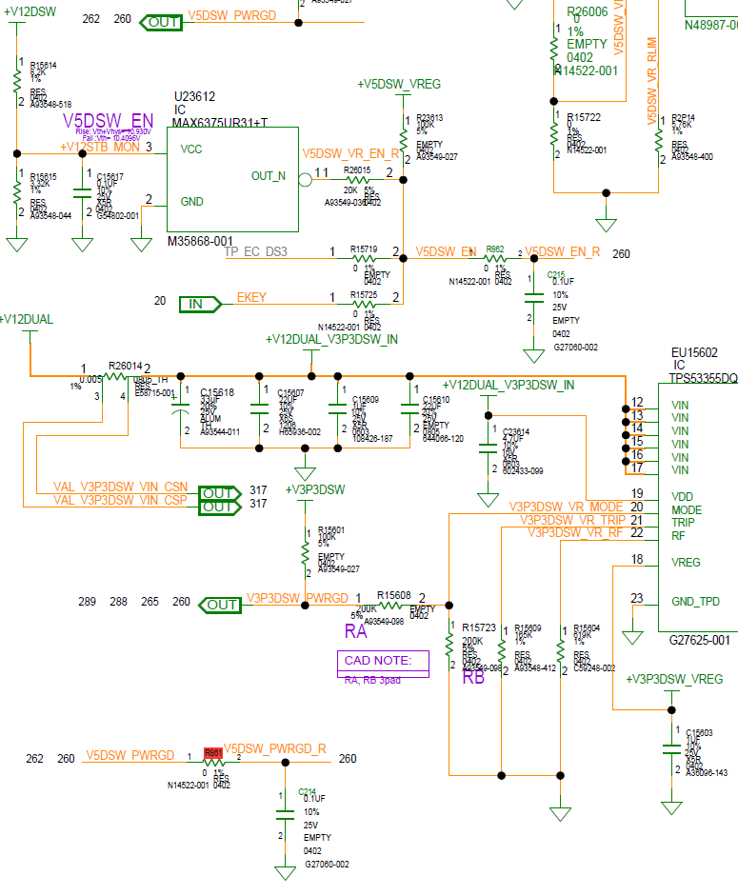
NVL-S RVP S-031 Bottom

Slide 8
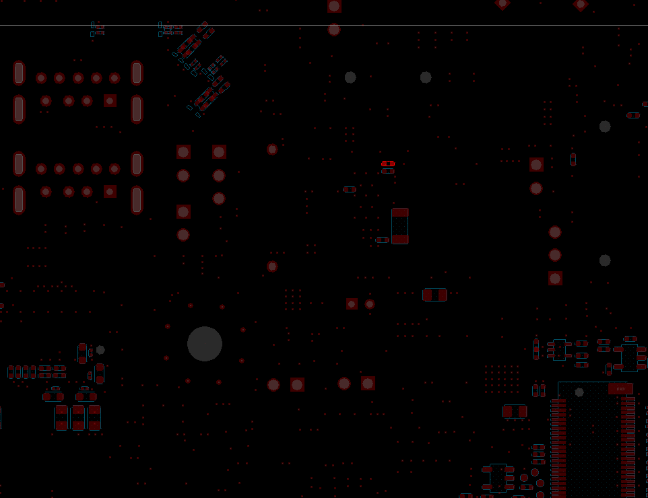
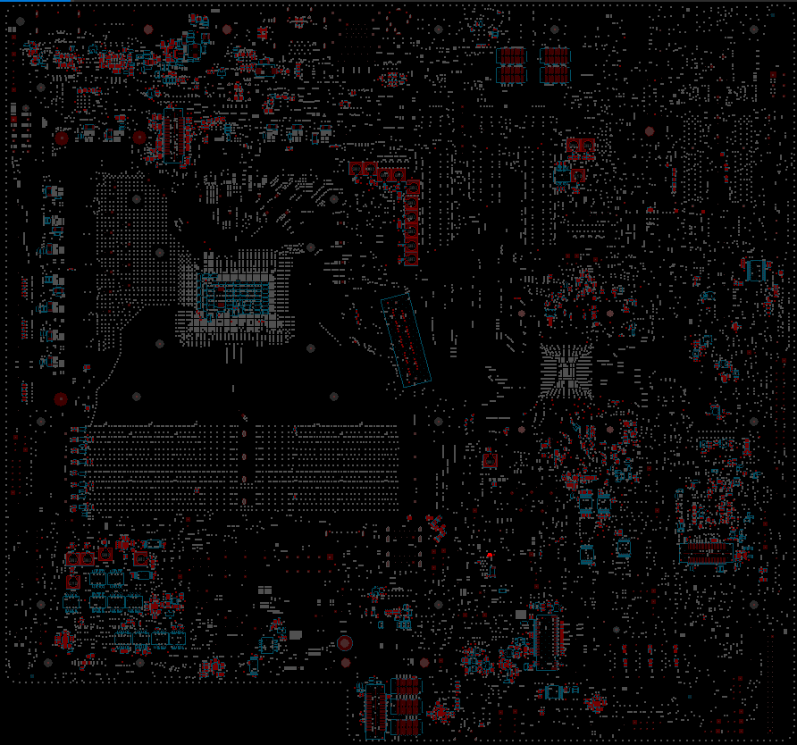
NVL-S RVP S-031
Step 1 of 2
Action | REFDES | Description
UNSTUFF | R861 | RES_D,0402,0OHM,1%,1/16W
R861
BOTTOM

Slide 9
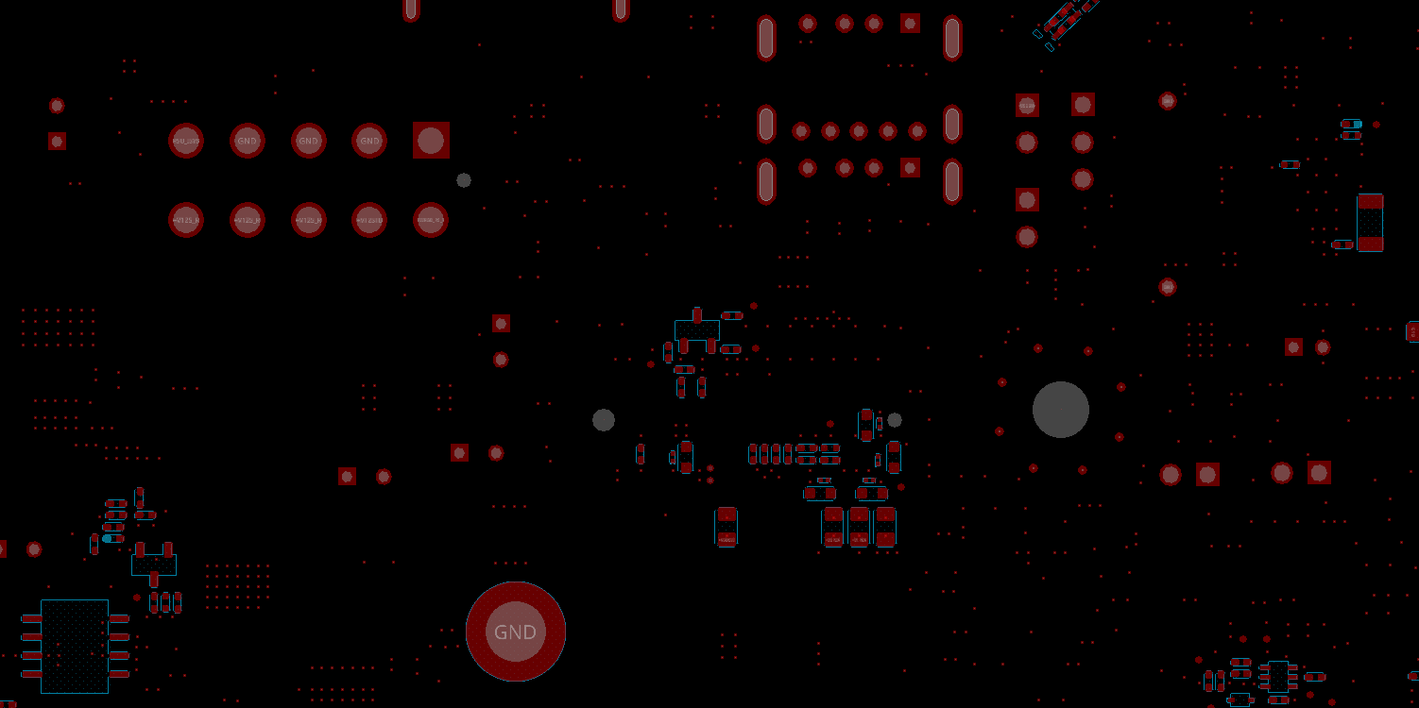
NVL-S RVP S-031
Step 2 of 2
Action | REFDES | Description
Blue Wire |  | Add a blue wire(~125mm) between R861 PIN2 and R15725 PIN2, and secure it to the board with tape.
tape
tape
R861 PIN2
BOTTOM
tape
R15725 PIN2

Slide 10
NVL-S RVP S-031
R-01A Resolving Boot Failure with Multiple USB Devices Connected Rework Summary-2
Action | Item | REFDES | Current IPN | Description | New IPN | Description
UNSTUFF | resistor | R861 | N14522-001 | RES_D,0402,0OHM,1%,1/16W | NA | NA
Blue Wire | NA | NA | NA | NA | Add a blue wire(~125mm) between R861 PIN2 and R15725 PIN2, and secure it to the board with tape.

